Slide 1
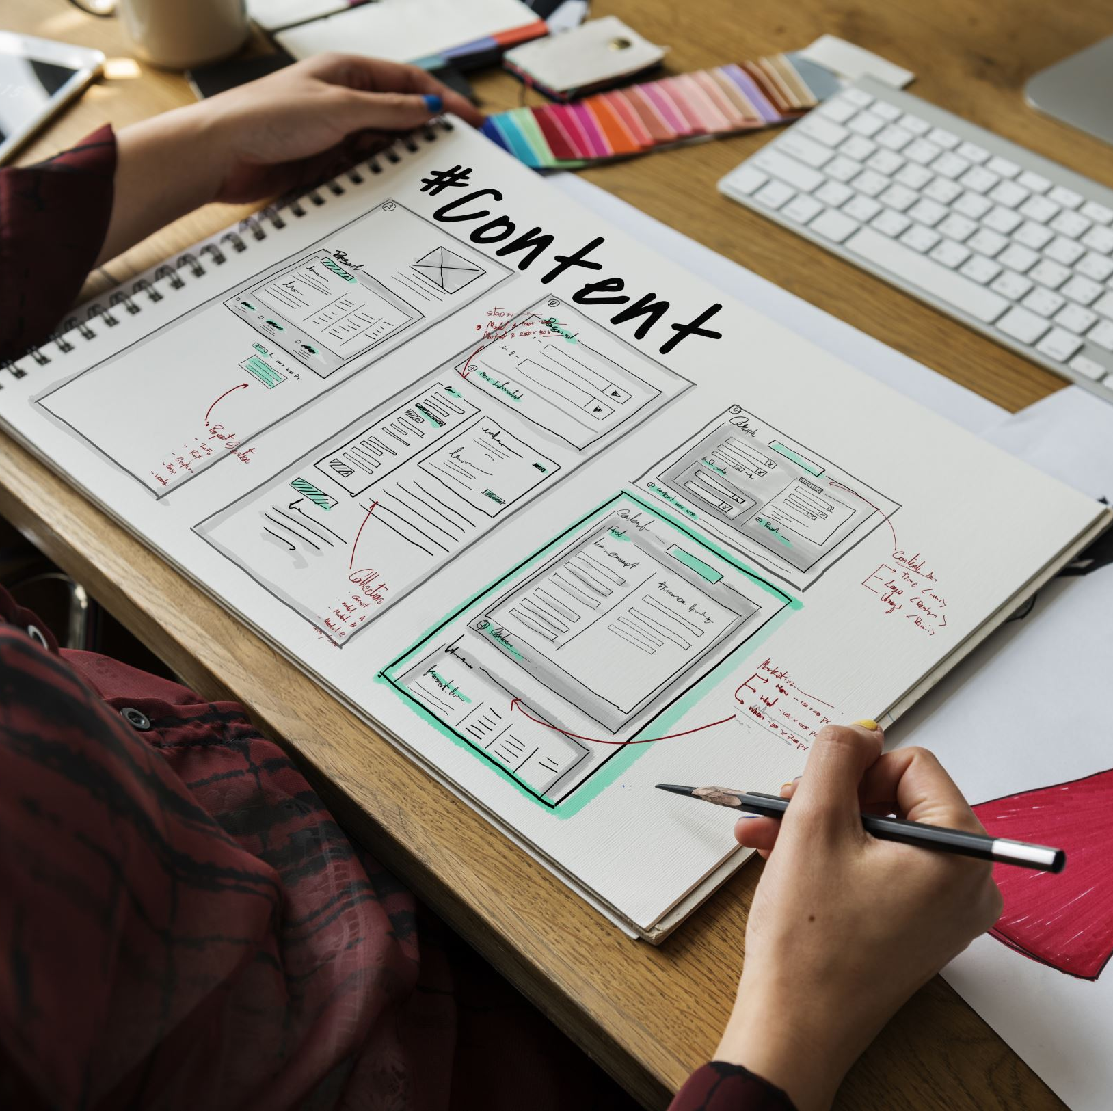
Comparison of Software Development Models
SER 416 – Assignment 1
Waterfall, Spiral, RUP, Agile
Bhupinder Singh
Course: SER 416
October 16th, 2025
Notes:
Hi, my name is Bhupinder Singh.
Out of the four software development models we studied in this assignment — Waterfall, Spiral, RUP, and Agile — I chose to make my video presentation on Agile.
software development model.

Slide 2
Model 1: Waterfall

Slide 3
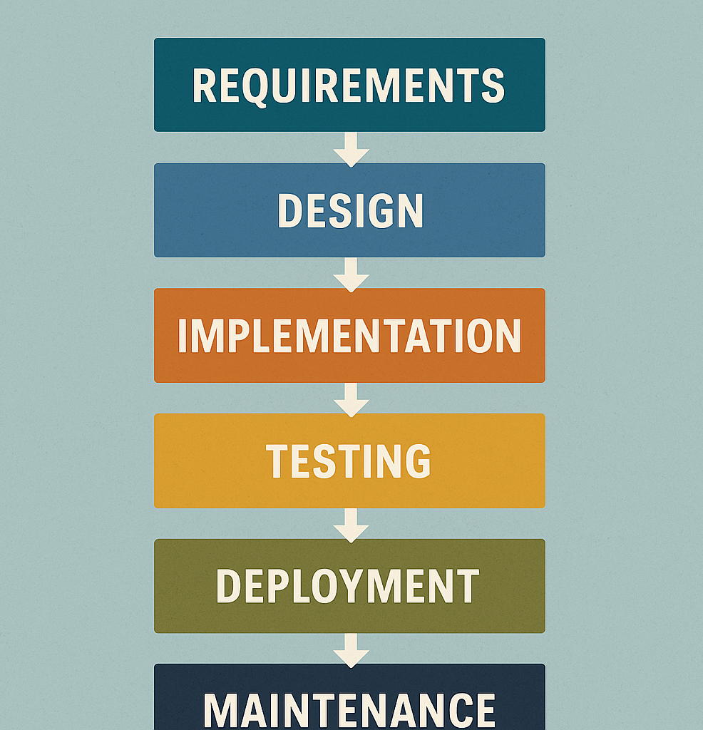
Waterfall – Key Characteristics
Linear and sequential approach
Divided into clear phases: Requirements, Design, Implementation, Testing, Deployment, Maintenance
Each phase must be completed before the next begins
Little customer involvement once requirements are finalized

Slide 4
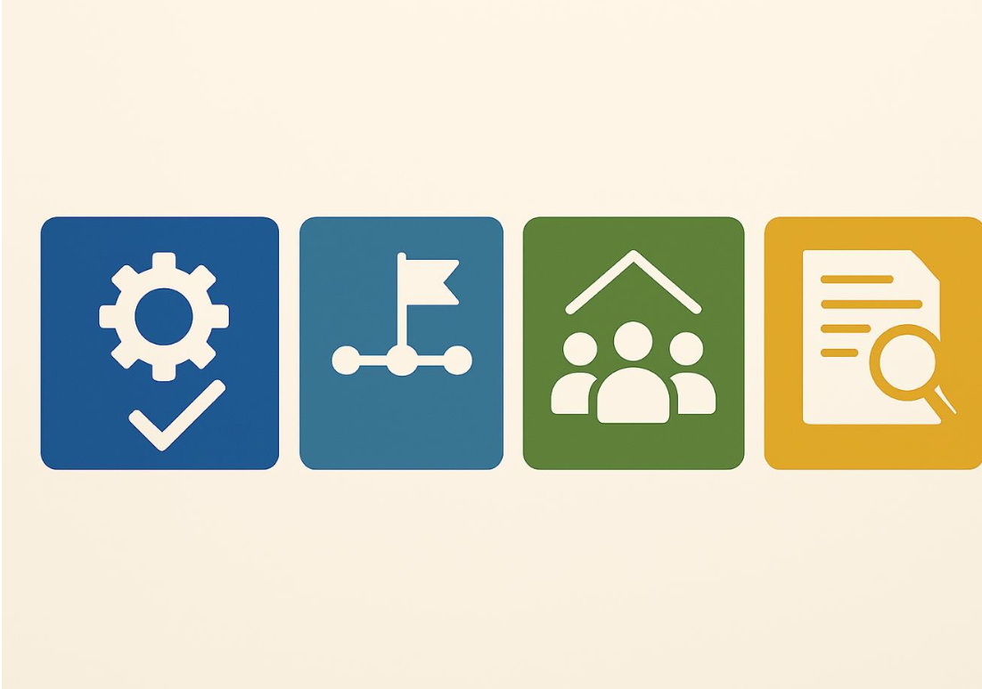
Waterfall – Strengths
Simple and easy to manage
Clear structure and milestones
Well-suited for small or well-understood projects
Thorough documentation ensures clarity

Slide 5
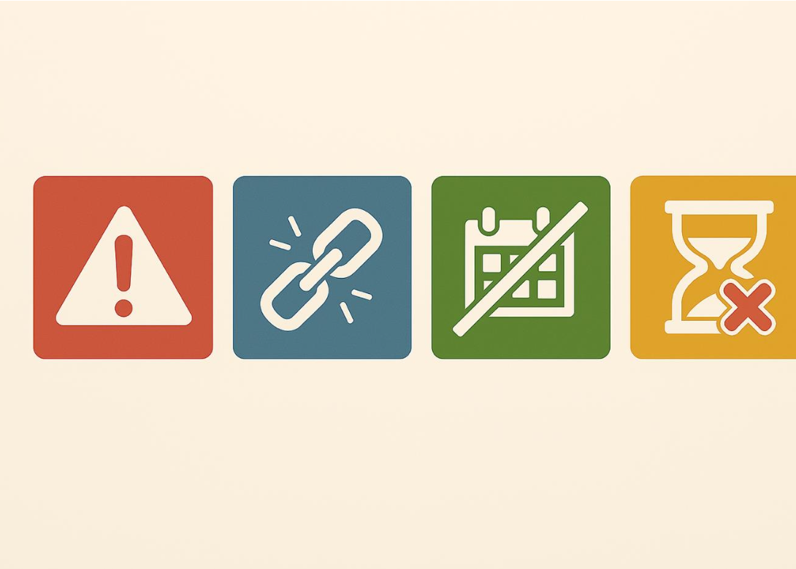
Waterfall – Disadvantages
Inflexible to changing requirements
Poor adaptability to changes after the project starts
High risk of project failure if errors exist in early phases
No working software until late in the lifecycle

Slide 6
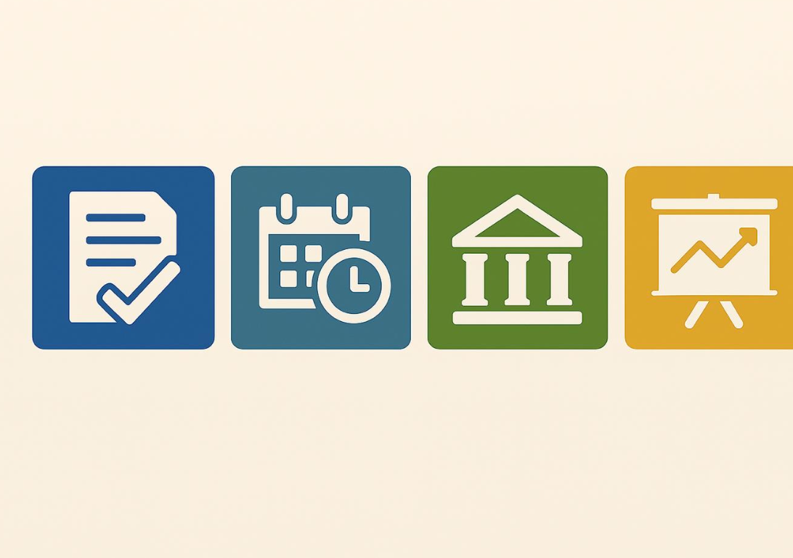
Waterfall – Best Use Case
Projects with well-defined, stable requirements
Short-term projects with predictable outcomes
Government or contract-based projects
Projects where documentation is more critical than flexibility

Slide 7
Model 2: Sprial

Slide 8
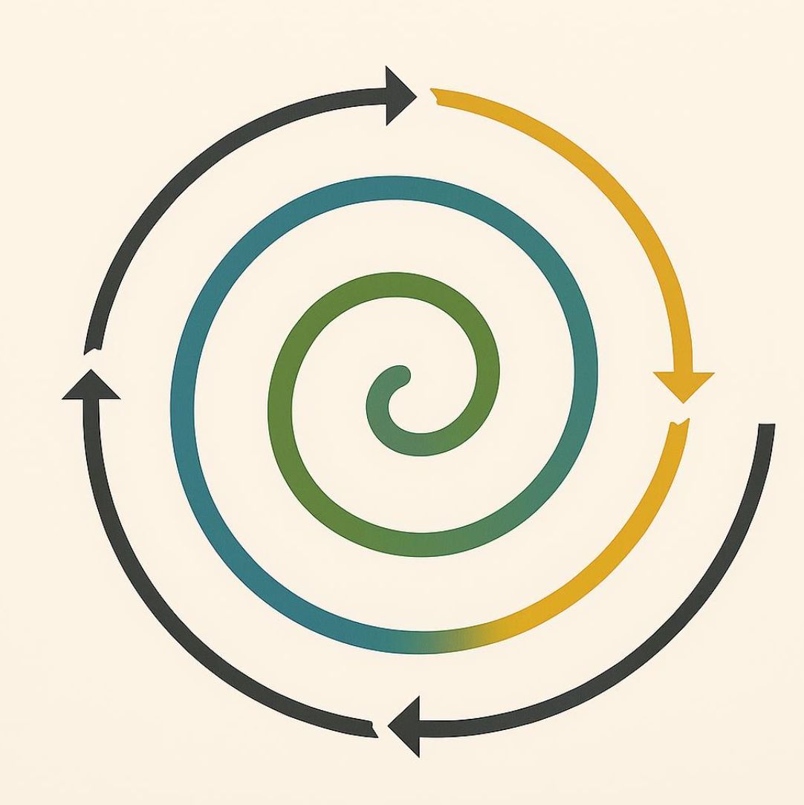
Spiral Model – Overview
The Spiral Model combines elements of both design and prototyping in stages, making it especially useful for large, complex, and high-risk projects.
It emphasizes risk analysis and iterative development.

Slide 9
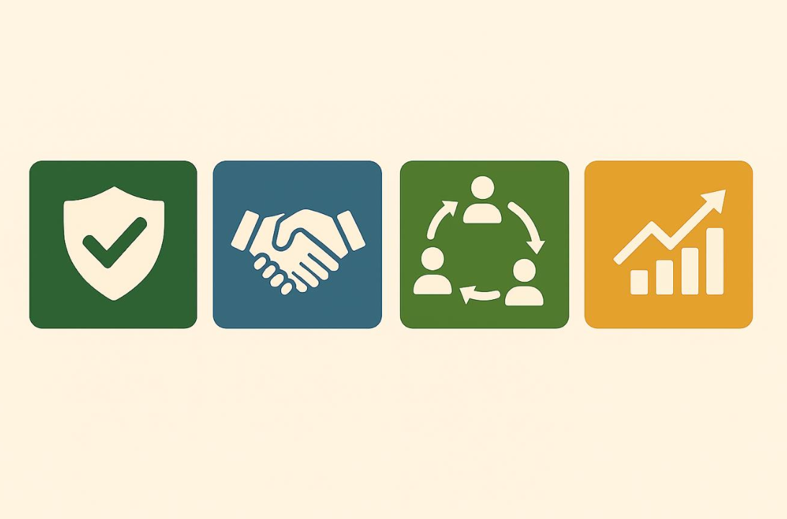
Spiral Model – Strengths
Strong focus on risk assessment and mitigation
Ideal for large and high-risk projects
Iterative nature allows refinement through multiple cycles
Stakeholders are involved throughout the process

Slide 10
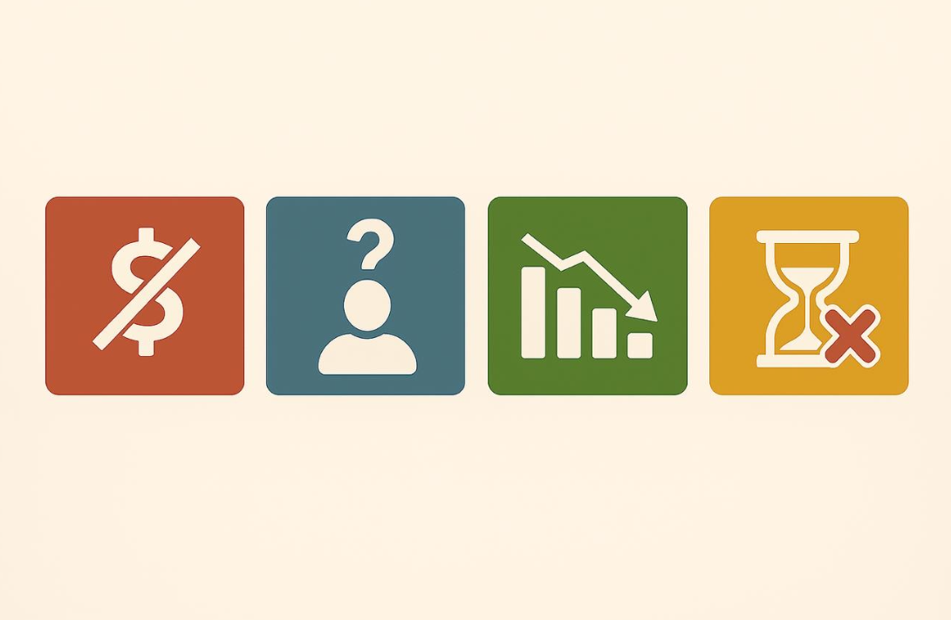
Spiral Model – Disadvantages
Can be expensive and complex to manage
Requires expertise in risk analysis
Not suitable for small or low-risk projects
Can lead to extended timelines if not managed properly

Slide 11
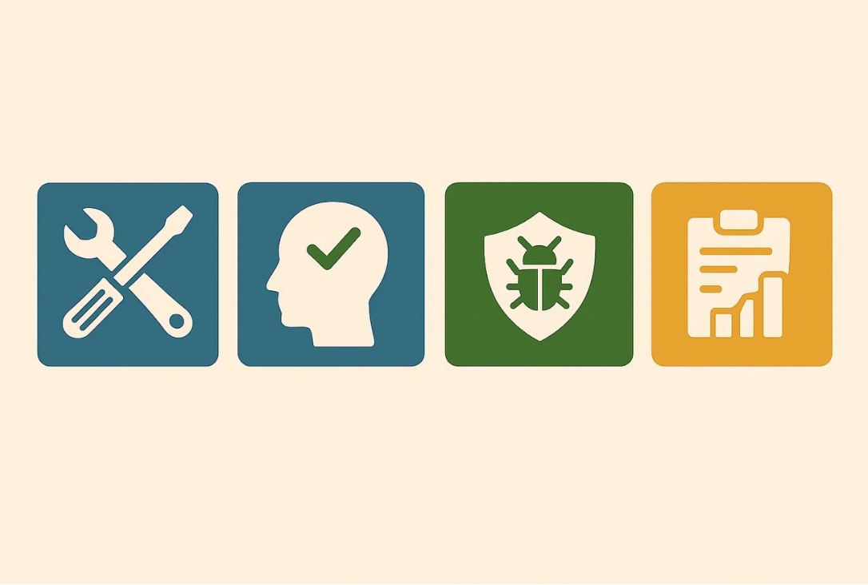
Spiral Model – Best Use Case
The Spiral Model is best used for:
- Large, complex software projects with evolving requirements
- Projects requiring continuous risk assessment
- Projects involving new technologies or unfamiliar domains
Example: Development of a medical software system with strict regulatory and safety requirements.

Slide 12
Model 3: RUP

Slide 13
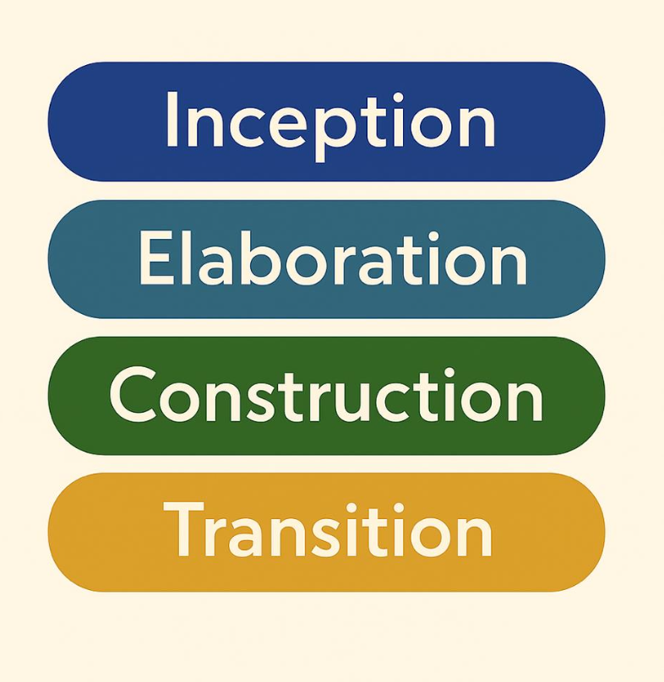
RUP (Rational Unified Process) – Overview
RUP is a software development process framework that emphasizes disciplined project management, requirements tracking, and iterative development in four distinct phases: Inception, Elaboration, Construction, and Transition.

Slide 14
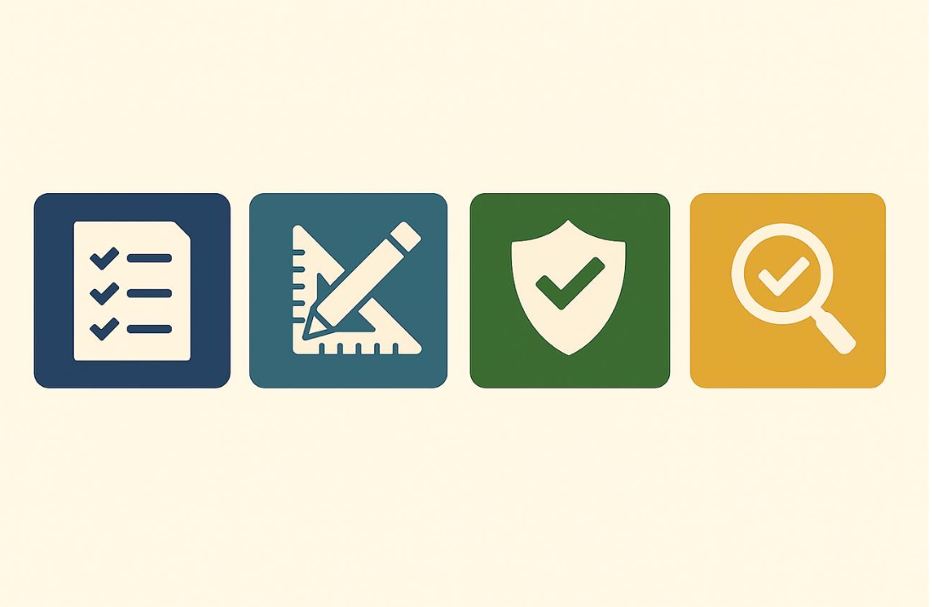
RUP – Strengths
Iterative and incremental development approach
Strong documentation and design focus
Supports risk mitigation early in the process
Scalable to large and distributed teams
Emphasizes testing and quality assurance

Slide 15
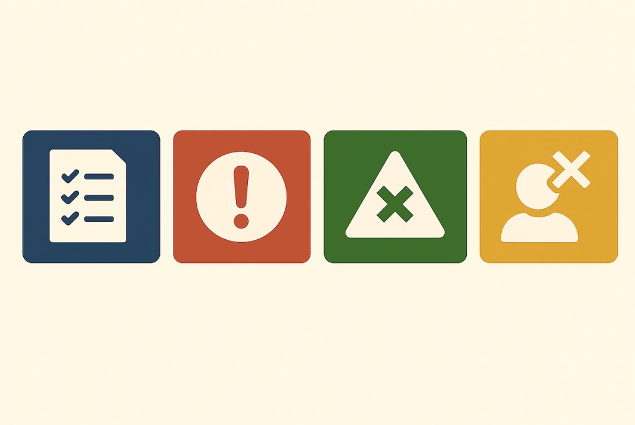
RUP – Disadvantages
Can be overly complex and heavyweight
Requires thorough training and expertise
Documentation-heavy process can slow down development
May not be flexible enough for fast-changing projects

Slide 16
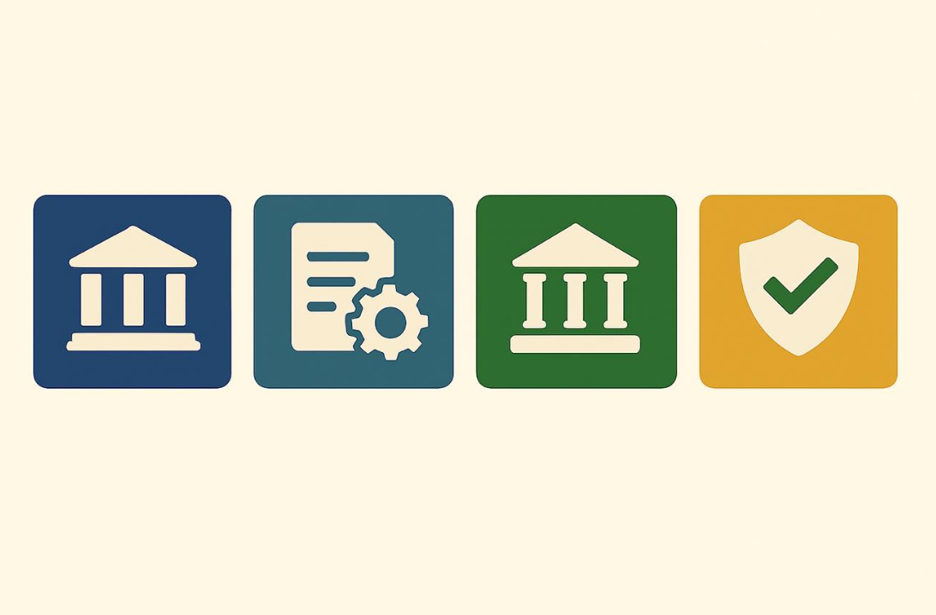
RUP – Best Use Case
RUP is best suited for:
- Large enterprise systems
- Projects where requirements are well understood but evolve over time
- Teams needing strong documentation and process control
Example: Developing a government or banking software system with strict compliance needs.

Slide 17
Model 4: Agile

Slide 18
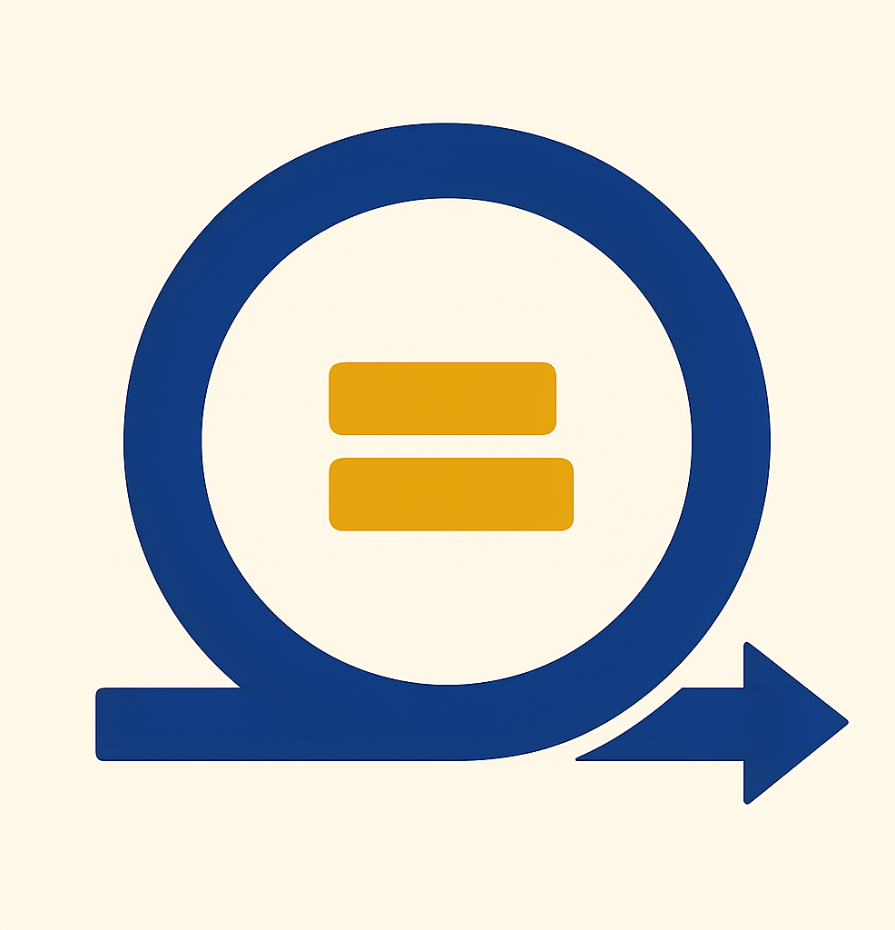
Agile Model – Key Characteristics
Iterative & incremental development
Focus on collaboration, early delivery, improvement
Short development cycles called sprints (1–4 weeks)
Adaptive planning and quick response to change
Cross-functional teams and strong communication
Based on Agile Manifesto values (e.g., working software > docs)
Notes:
Agile is a flexible way to build software. Instead of doing everything step by step like in Waterfall, Agile breaks work into small pieces called sprints.
Each sprint usually takes one to four weeks.
At the end of each sprint, the team shares working software and gets feedback.
The goal is to work closely with the customer and make changes as needed during the project—not just at the end.”

Slide 19
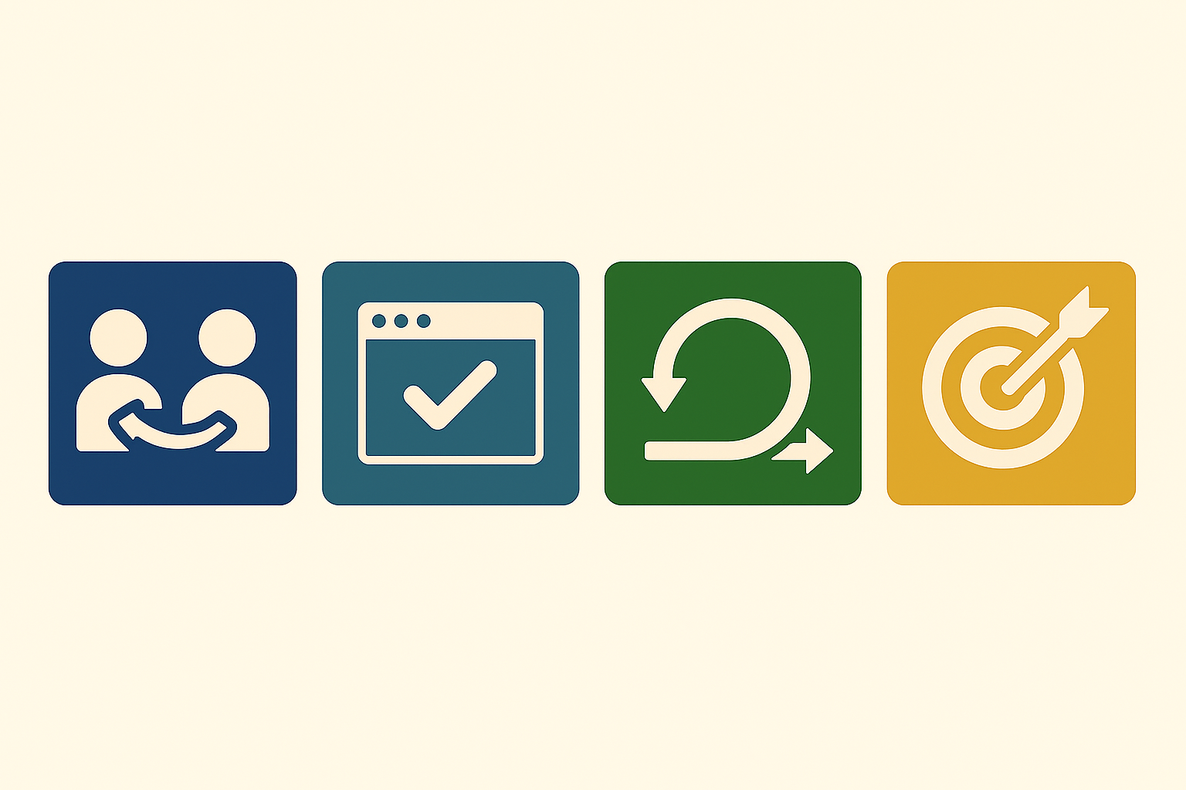
Agile – Strengths
High customer involvement and satisfaction
Rapid delivery of working software
Flexible to changing requirements
Encourages team collaboration and ownership
Continuous feedback and improvement
Notes:
“Agile has a lot of good points.
One, it keeps the customer involved the whole time, so they know what’s going on.
Two, working software is shown early and often, so people see progress fast.
Three, it’s easy to make changes if the customer wants something different.
Also, the team works together closely, which helps solve problems faster.
And with feedback every sprint, both the team and the product keep getting better.”

Slide 20
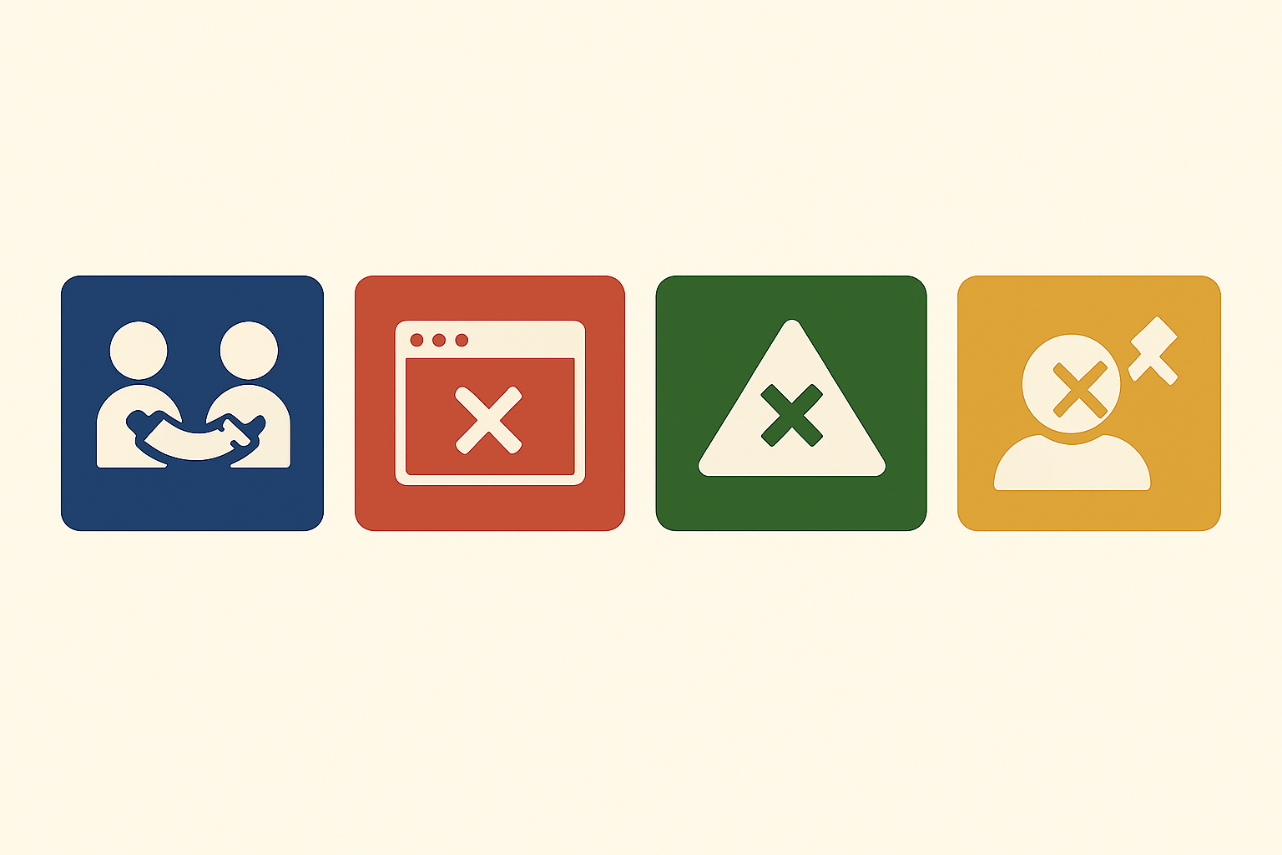
Agile – Disadvantages
Requires active and consistent customer participation
Difficult to scale for large, complex projects
Less emphasis on documentation
Can lead to scope creep without disciplined management
Notes:
“But Agile also has some downsides.
It needs the customer to be active and available throughout the project.
For big projects, Agile can be harder to manage without extra tools or structure.
Also, because the focus is on working software, sometimes the team doesn’t write enough documents.
And if the team isn’t careful, the project can go off track or take longer than planned.”

Slide 21
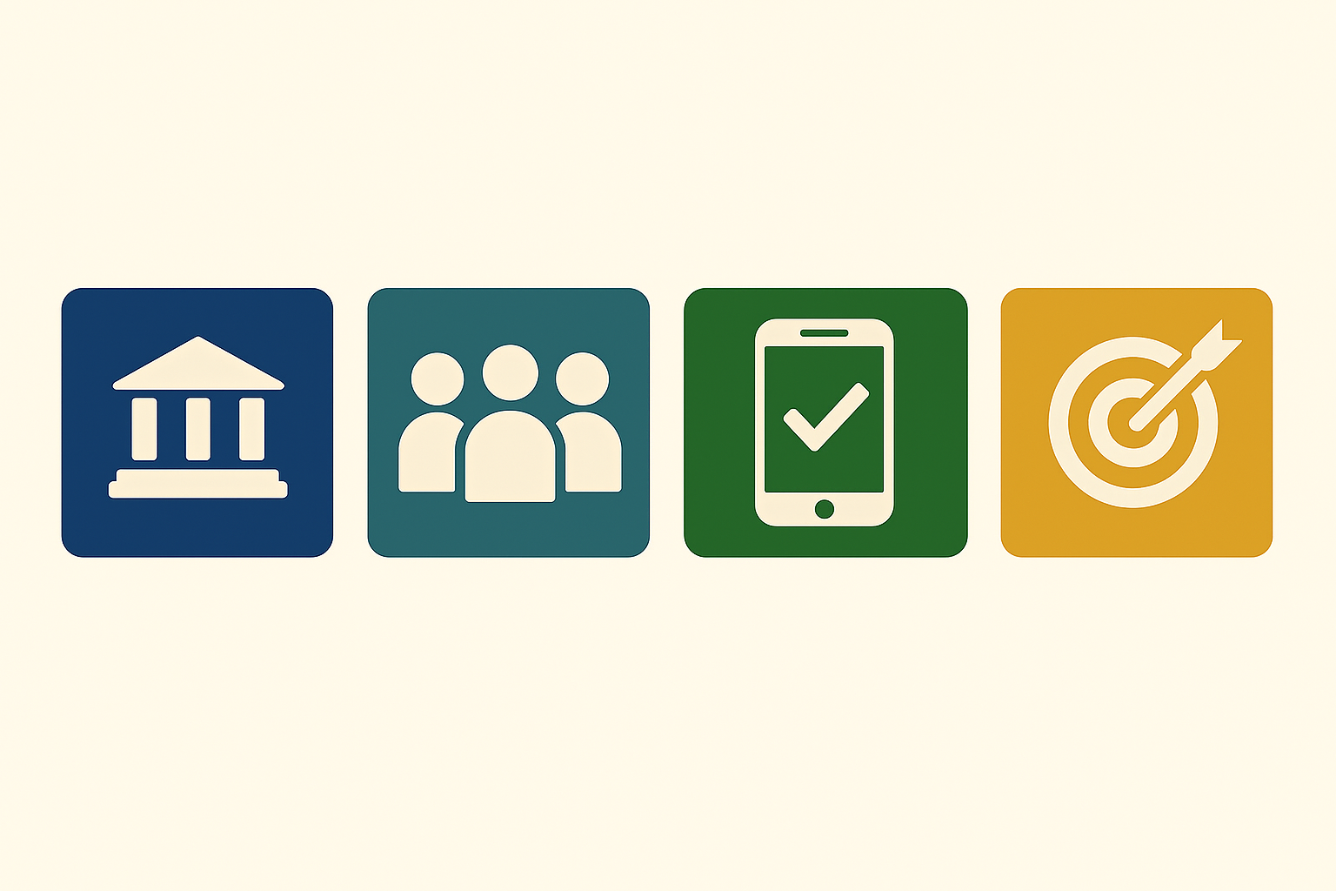
Agile – Best Use Case
Agile is best suited for:
- Projects with evolving requirements
- Small to medium-sized teams
- Startups and fast-paced product development
Example: Building a mobile app where frequent user feedback is crucial.
Notes:
“Agile works best when things are likely to change or when the team wants to move fast.
It’s a good choice for apps or websites, or any project where you want to test ideas quickly and get feedback.
Small and medium teams, especially in startups, use Agile a lot.
If you want to build something step by step and keep improving it, Agile is a great method.”
“Thanks for watching my Agile model presentation.
I hope this helped you understand how Agile works and when it’s a good fit.”

Slide 22
Project Models – Summary Comparison
Aspect | Waterfall | Spiral | RUP | Agile
Approach | Linear & Sequential | Iterative with Risk Analysis | Iterative and Structured Phases | Iterative & Incremental
Planning Style | Heavy Upfront Planning | Risk-Driven Cycles | Phase-Based with Clear Roles | Flexible, Continuous Planning
Customer Involvement | Low | Medium to High | Medium | Very High
Risk Handling | Poor | Strong (focus on risk assessment) | Moderate | Adaptive, relies on feedback loops
Change Flexibility | Rigid (hard to change mid-way) | Allows for changes between iterations | Moderate – Supports changes at key stages | Very Flexible – Welcomes change
Best For | Well-defined, stable requirements | High-risk, complex, exploratory projects | Large-scale systems with defined workflows | Fast-changing projects, startups, user-focused apps
Documentation | Heavy | Moderate to Heavy | Detailed & Role-Based | Light & Just-in-Time
Team Size | Medium to Large | Large (due to complexity & risk tracking) | Medium to Large | Small to Medium

